Slide 1
How CBDC enhances the role for Mojaloop in developing economies.
David Mangini
david.mangini@gioridigital.com

Slide 2
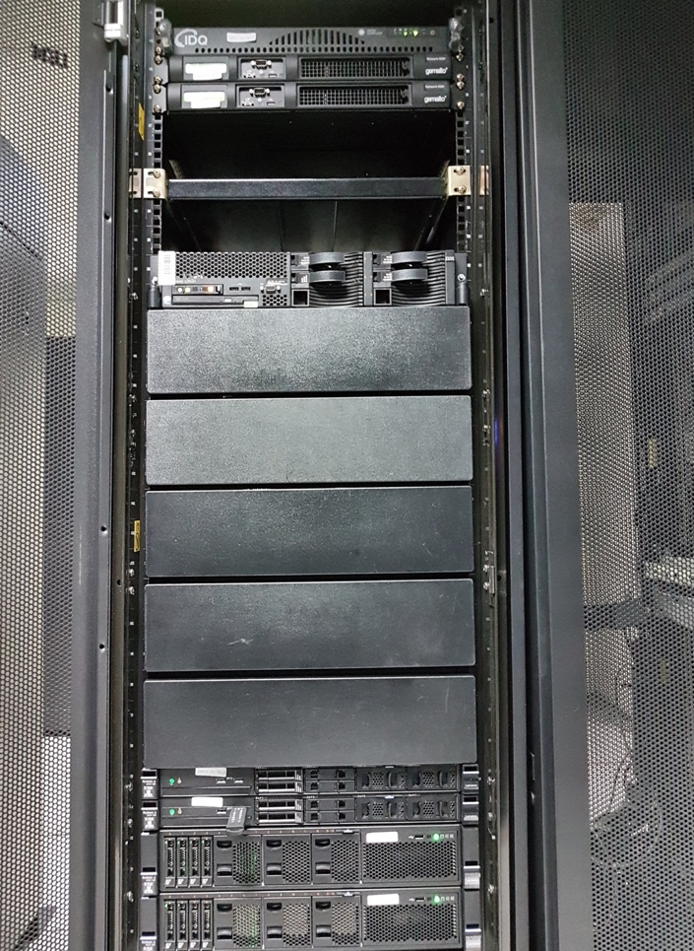



Who is Giori Digital and what is our business?
The Giori name has decades of proven experience with Central Banks
Organization Giori and De La Rue Giori had 70 years in printing 98% of the world’s banknotes
Giori Digital
now creates the
digital banknote

Slide 3
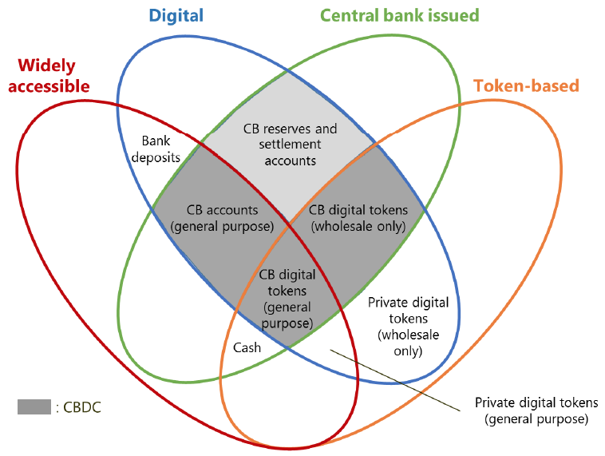

Giori Digital provides a solution for Retail Central Bank Digital Currency (CBDC)
GSMT – Global Solutions for Money Technology
GSMT is for Retail CBDC use
Controlled by the Central Bank
Centralized, Token-based
GSMT is the closest to ‘Cash’
Source: BIS CPMI CBDC
March 2018

Slide 4


Wholesale CBDC versus Retail CBDC
CBDC is defined at both levels of the Central Bank relationship
Central Bank
Licensed Institutions
Users Population
Wholesale CBDC
Reserves only
Claim on the Central Bank
Retail CBDC
Distributes Retail CBDC to Users

Slide 5
Most Central Banks are focused on Retail CBDC
Representing 63 countries and 5.6 billion (80%) of the world’s population
Yes
No
Percent of respondents conducting work on CBDCs
Source: BIS Paper No 101, January 2019

Slide 6
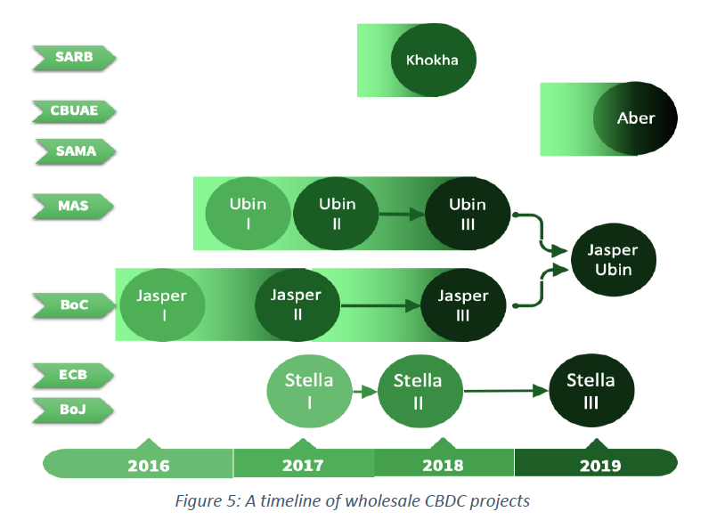
Major Wholesale CBDC Projects
Helvetia
Switzerland
BNS
Inthanon
Thailand
BoThai
South Africa
U.A.E
Saudi Arabia
Singapore
Canada
Europe
Japan

Slide 7
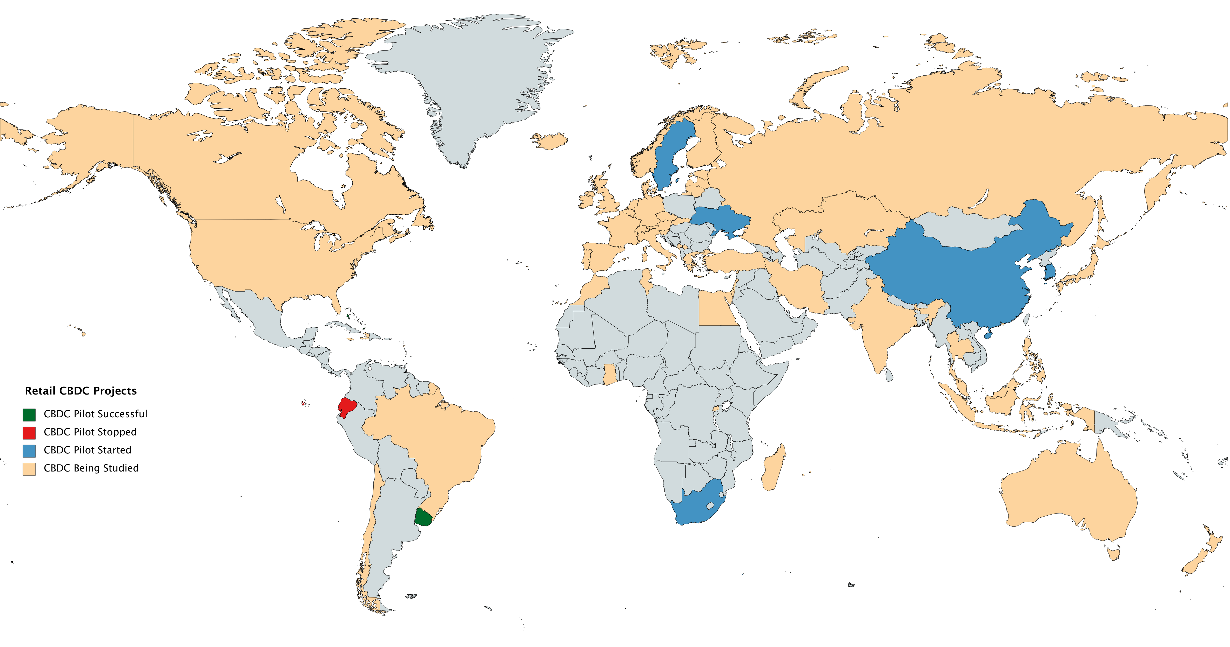
CBDC Studies and Projects underway
Retail CBDC Projects
CBDC Pilot Successful
CBDC Pilot Stopped
CBDC Pilot Started
CBDC Being Studied

Slide 8
What is the problem Central Banks must solve?
Private forms of money are replacing Central Bank money
Address the legacy issues of cash while protecting Economic, Social and Security concerns
Economic
Maintaining controls for monetary policy
Security
Safety of payments,
Sovereign control
Social
Financial inclusion, tax evasion, corruption

Slide 9



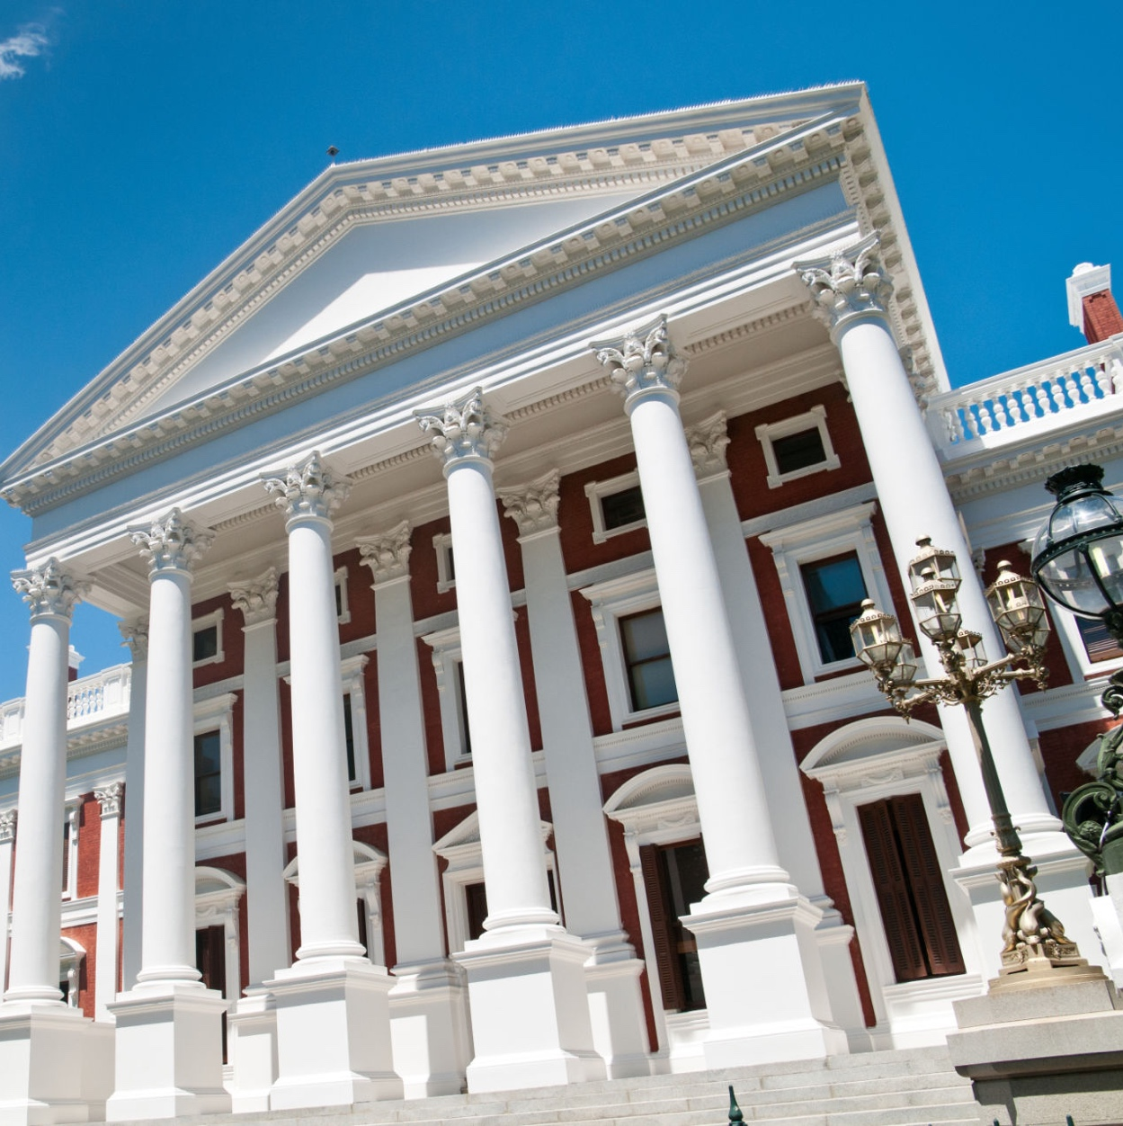


Build an Ecosystem that Benefits Everyone
BANKS
GOVERNMENTS
MERCHANTS
USERS
A bank can use the code to modify its internal systems so that they easily interoperate with other payments providers
Government could use Mojaloop to deliver support payments to citizens right into their mobile wallets, etc.
Customers can pay their bills directly from their phones
Customers don't need to pay significant fees to send money to their relatives in rural areas
CBDC
Notes:
Because Mojaloop is open source and interoperable - everyone can build something amazing on top of it.
By enabling a system that assists in routing payments directly from sender to recipient
Government could use Mojaloop to deliver support payments to citizens right into their mobile wallets etc.
By simplifying the payments infrastructure that will allow connections to various platforms, it helps local developers focus on innovating -- like building out a business-to-business payroll processing system that would allow companies to pay semi-formal employees directly into their mobile wallets.
Did you know that out of the two billion workers in informal employment worldwide, over 740 million are women? Consider the impact of women employees receiving their salary straight into their mobile wallets.
Customers can pay their bills directly from their phones. Women with a digital wallet can connect with their employer’s bank account and or their children’s school account to complete monthly transactions, even if they are on different platforms.
Customers don't need to pay significant fees to send money to their relatives in rural areas even if it is through credit unions or microfinance institutions etc.
It can empower anyone -- any unbanked woman -- with a mobile phone to receive a salary payment, send money to other wallets, buy things, pay bills and more. But, more importantly, it can help the underserved women to become economically active or reach more customers.
Then it opens up opportunities for the “effect” of turning the underserved into the newly served.
For example, local developers could build out a B2B payroll processing system that would allow companies to pay semi-formal employees right into their mobile wallets.
Government could use Mojaloop to deliver support payments to citizens right into their mobile wallets, etc.
Having real-time payments means that people don't have to drive to wait in line to pay a bill (they do it from their phone)
It means that they don't need to pay significant fees to send money to their relatives in rural areas
It means that customers can pay businesses quickly and easily rather than waiting until they can "get a ride into town"
Basically, all the value of mobile money, without the limitations of mobile wallets.

Slide 10


Central Banks & Governments Benefit from Inclusive RTPS
Built and operated by public institutions
Digital infrastructure supports public and private sector innovators
Provides a channel for regulators to directly address financial stability concerns
Possible for all firms – irrespective of size – to have equal access to platforms
Banks, fintech, and mobile providers can operate on the same regulated platform
Creates a network effects that lower costs and improve processes
Uses fiat currency or digital CBDC guaranteed and regulated by the Central Bank

Slide 11





Inclusive, Open Payment System Rails Drive Ecosystem Growth
Apps
Innovation Market for Value Added Services and Products
Competition
Space
Accounts
Digital Accounts and Transactions
Rails
Infrastructure for Connectivity and Interoperability
Intervention
Areas
Collaboration
Space
CBDC
Rules
Regulatory and Governance Framework

Slide 12

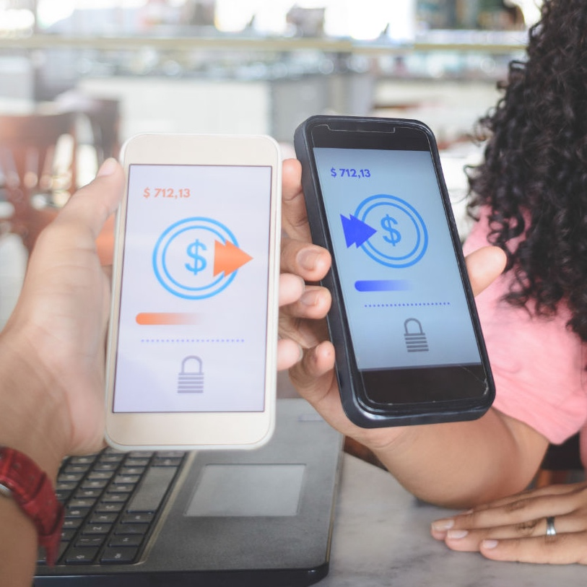
Inclusive Payment Models Can Help the Underserved Gain Financial Access
GOING MOBILE
Adults reporting using a mobile phone for financial transactions
The Global Findex: affordable digital financial access are key
Kenya
Sudan
Gabon
Algeria
Congo, Rep.
Somalia
Albania
Tajikistan
Uganda
Angola
68%
52%
Worldwide without an account, citing lack of money as the obstacle to use of formal financial services
50%
2/3
16%
44%
OF ADULTS
37%
34%
1/3
Also blame the cost of opening and maintaining an account or the banks being too far away.
In Sub-Saharan Africa, where traditional banking has been hampered by transportation and other infrastructure problems, mobile money services have expanded to 16% of the market.
31%
OF ADULTS
29%
27%
26%
Notes:
Source:: The World Bank‘s view of the state of financial inclusion in Africa
Going Mobile
The Global Findex shows mobile financial services may help historically unbanked regions gain financial access
2/3 of Adults
Worldwide without an account cite lack of money as the obstacle to use of formal financial services
1/3 of Adults
Also blame the cost of opening and maintaining an account or the banks being too far away.
In Sub-Saharan Africa, where traditional banking has been hampered by transportation and other infrastructure problems, mobile banking has expanded to 16% of the market.
Adults reporting using a mobile phone for money transactions
Kenya: 68%
Sudan: 52%
Gabon 50%
Algeria 44%
Congo, Rep. 37%
Somalia: 34%
Albania: 31%
Tajikistan: 29%
Uganda: 27%
Angola: 26%

Slide 13
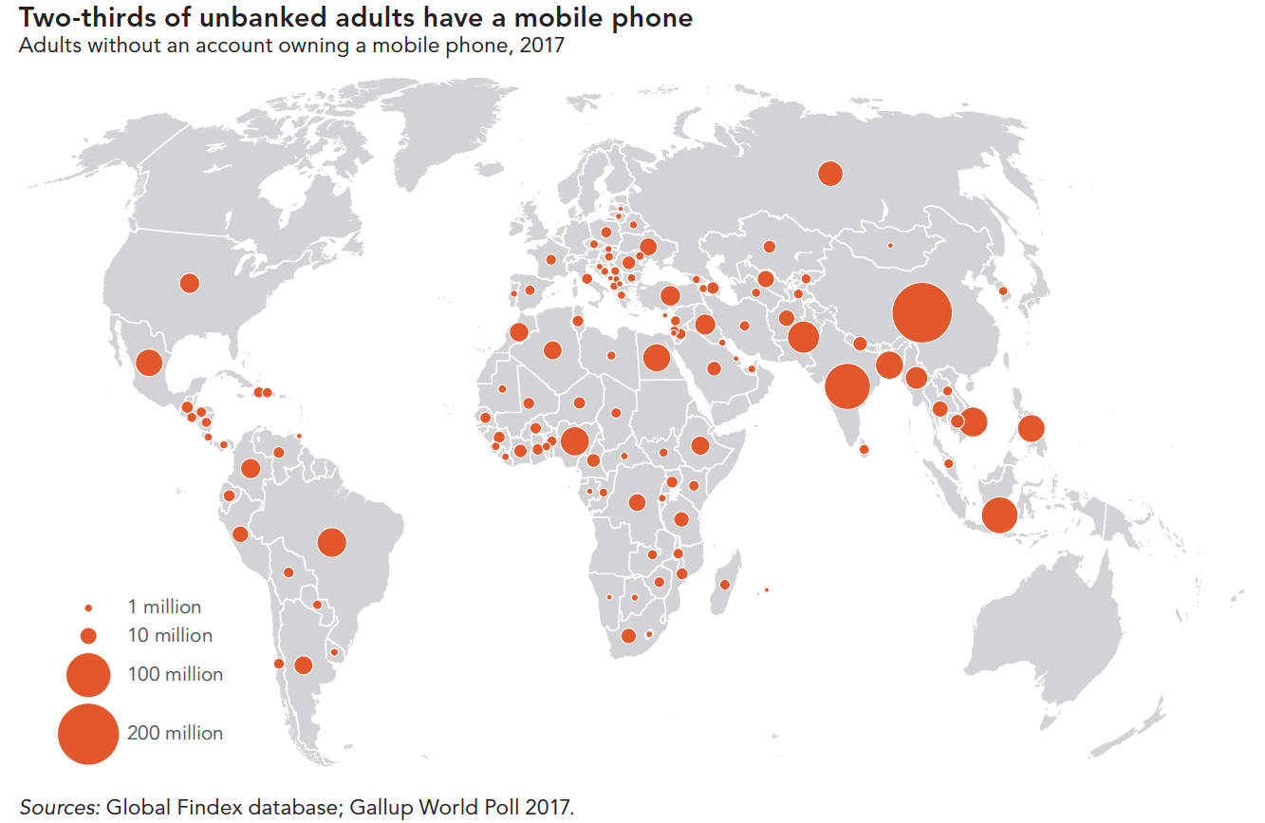
Mobiles among the unbanked provide immediate CBDC access
Large populations are dependent on cash payments across the world
More than 80% of transactions are still in cash
Lack of local services from commercial banks
CBDC funds are safer than private mobile funds
CBDC allows faster circulation of money to increase GDP
Reduces the production volume of banknotes / coins and environmental impact
66% of unbanked in the world have a mobile phone

Slide 14
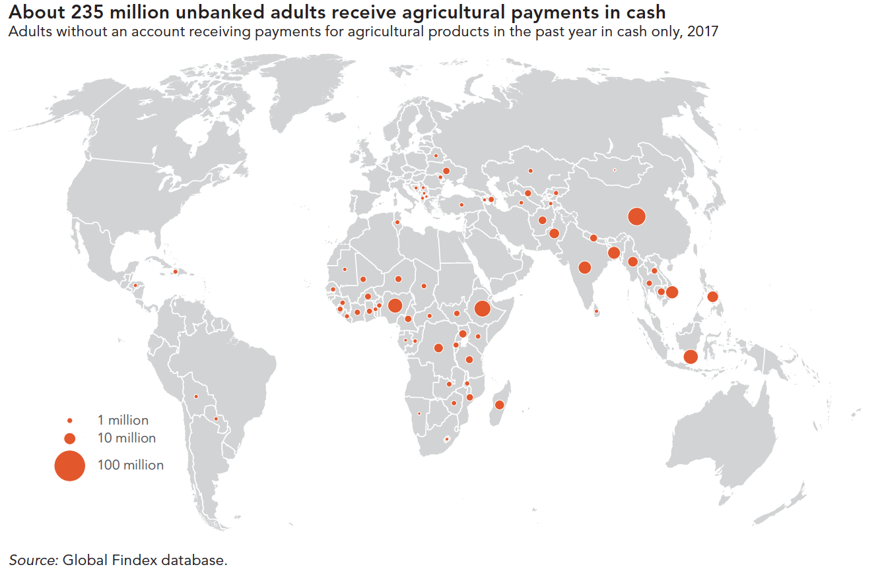
Market Example: Cash use in Sub-Saharan Africa
235 million unbanked people receive farm pay in cash
Large populations in Africa are dependent on cash payments
Rates of mobile phones among the unbanked allows for immediate CBDC access
CBDC offered over mobile is safer and less expensive for users and merchants

Slide 15
Global Market for CBDC
Very Small:
< 500,000 pop
70 countries
29%
Small:
0.5m to 5.0m p
50 countries
20%
Medium:
5m to 25m p
70 countries
29%
Large:
25m to 100m p
40 countries
17%
Very Large:
> 100m pop
12 countries
5%
TOTAL:
242 countries
100%
Viable?
Strongest market model
Bespoke, internal and custom solutions
Focus for Financial Inclusion
Focus for Higher Unbanked
Focus for Lower UN-HDI

Slide 16
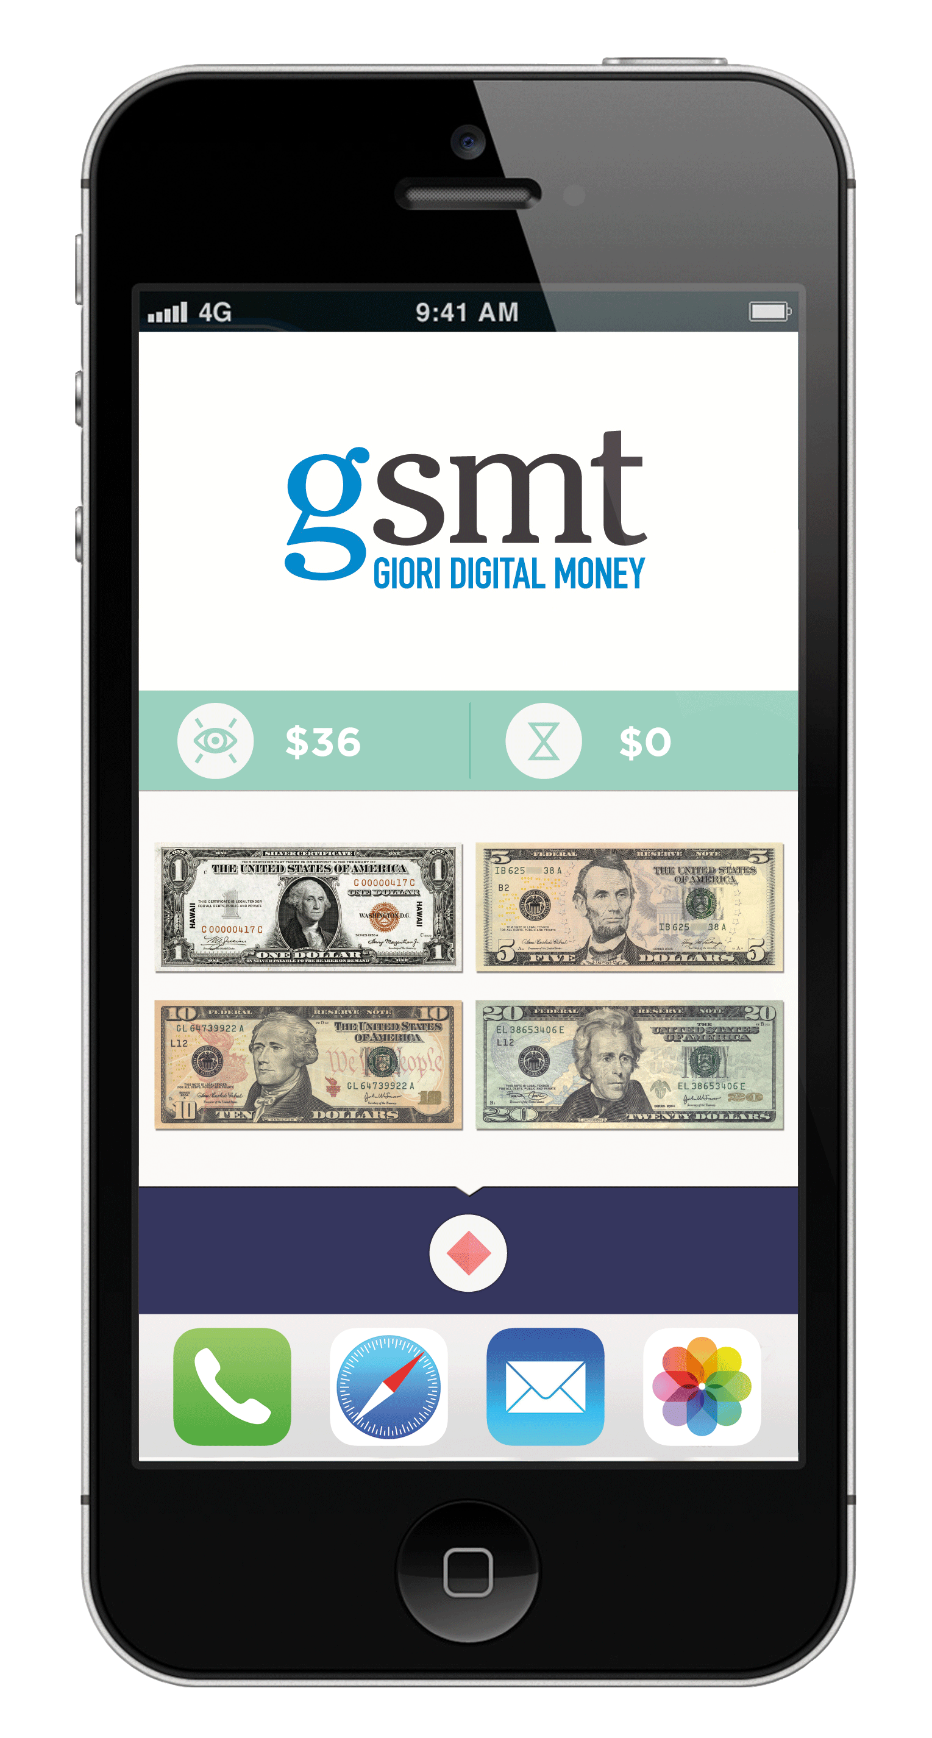

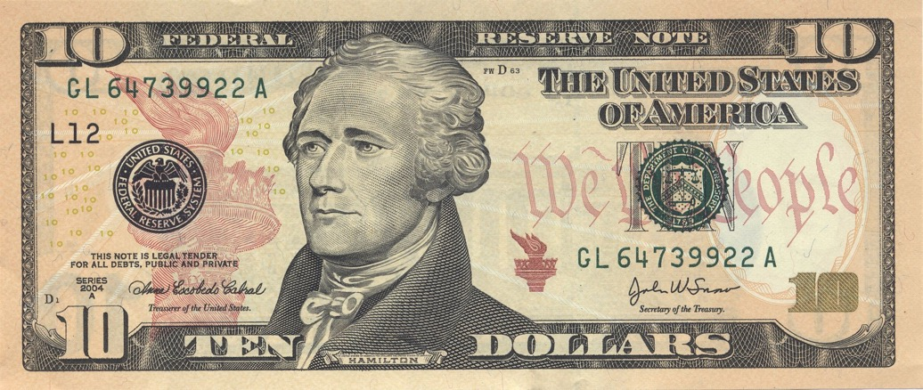
GSMT transforms sovereign M0 money into digital banknotes

Slide 17
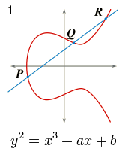

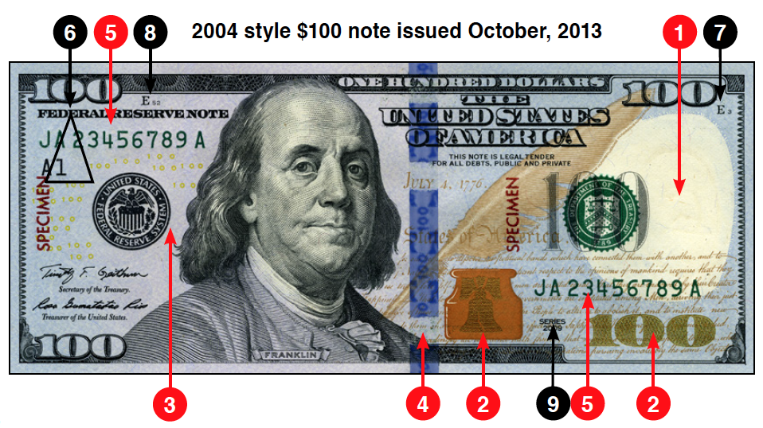

Banknotes will circulate alongside digital CBDC
Security features on present banknotes
Digital security features
Quantum
Number
Generation
Elliptical Curve
0105330b
VERSION
100
DENOMINATION
USD
CURRENCY
8280360411257395
SERIAL NUMBER
0B3F7E787D38B11C43FF76
RANDOM NUMBER
21.01.2020
PRODUCTION DATE
0120.37MVDE.4938.PDM.95
PRIVATE DATA
678385430358EEF88AB345346456ABFFDDEE868FE757570
CENTRAL BANK SIGNATURE

Slide 18
GSMT eNotes are fungible, verifiable, and persistent
GSMT eNote
eNotes are produced exclusively by the Central Bank
eNotes are produced in the quantities required to meet demand
eNotes are defined in denominations as defined by the Central Bank
Every eNote is individually serialized and digitally signed by Central Bank
eNotes remain unaltered, persistent throughout circulation and use
Central Bank has full lifecycle control to audit and replace eNotes as the changes in technology require
0105330b
VERSION
100
DENOMINATION
USD
CURRENCY
8280360411257395
SERIAL NUMBER
0B3F7E787D38B11C43FF76
RANDOM NUMBER
21.01.2020
PRODUCTION DATE
0120.37MVDE.4938.PDM.95
PRIVATE DATA
678385430358EEF88AB345346456ABFFDDEE868FE757570
CENTRAL BANK SIGNATURE
Digital Signature ensures the authenticity and integrity of every individual eNote in circulation

Slide 19
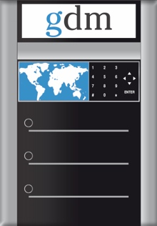


GSMT solution layout for Retail CBDC
gsmt
gwa
and
eNotes
API
Central Bank
Licensed Institutions
Other existing payment systems
Generate / Issue
Distribute / Circulate
Dual systems with isolation of functions and independent administration
Adaptable to apply to 1-tier distribution or 2-tier distribution
API Interfaces for services with the existing payment ecosystem
Payment application to initiate service (GWA) in the testing phase

Slide 20
In GSMT, the Central Bank can choose the distribution model
Central Bank
Issue
Circulate
Payment System
1 Tier
eNotes
gdm
eNotes
eNotes
gem
API
Central Bank
Private Institutions
Issue
Circulate
Payment System
eNotes
gdm
eNotes
eNotes
gem
API
2 Tier
Central Bank
Private Institutions
Issue
Circulate
Payment System
eNotes
gdm
eNotes
eNotes
gem
API

Slide 21



Transfer of CBDC Ownership:
CBDC in dReserve at Central Bank:
Central Bank
CBDC Operator
Balance Sheet Owner
gdm
gem
Central Bank | CBDC Operator | User
eNote
dReserve
dSafe
User dWallet
eNote
CBDC in Operator dSafe :
Central Bank
CBDC Operator
Balance Sheet Owner
gdm
gem
Central Bank | CBDC Operator | User
eNote
dSafe
User dWallet
eNote
dReserve
CBDC in dWallet of the User:
Central Bank
CBDC Operator
Balance Sheet Owner
gdm
gem
Central Bank | CBDC Operator | User
eNote
dReserve
dSafe
User dWallet
eNote

Slide 22
Not all Money is the same
Central Bank money can never mix with Commercial Bank money
There must always be an exchange.
Central Bank
Private Money
Foreign CBDC
LEGAL CLAIM Central Bank
BACKING Guaranteed by the Central Bank
CONVERTIBILITY Domestically at par with fiat banknotes and coins
LEGAL CLAIM Private Institution (Balance Sheet Liability)
BACKING Reserve assets or the solvency of the Institution
CONVERTIBILITY Market Rates
LEGAL CLAIM Foreign Central Bank
BACKING Guaranteed by the Foreign Central Bank
CONVERIBILITY Through Foreign Exchange
Foreign currency adds complications/forex
Foreign CBDC can impact on domestic monetary policy.
Notes:
The slide speaks for itself. Emphasize efficiencies of community development, rapid response on security fixes, Community vs. Vendor Lock-in

Slide 23


Settlement of payments across the Public / Private domains
FSP A provides the back-office function to reconcile their settlement ledger with CBDC reserves
FSP A
FSP B
Settlement
Provider
Ledger-based Payment System
FSP A Ledger
Bob
FSP A is also the licensed operator of the GSMT GEM
CBDC <-> Private
Exchange of different monies of the same currency
FSP B Ledger
Bob’s Account
Mobile Payment App
Hub
Alice
gsmt
gwa
Alice’s Wallet
FSB A
dSafe
FSP A
FSP B

Slide 24
What is the impact of using CBDC?
CBDC is a safer source of funds than private monies.
CBDC allows immediate and direct disbursement of social benefit payments to the public.
CBDC can benefit from the interoperability provided by the Mojaloop hub.
Users can access CBDC through their existing mobile devices – no special device or special software is needed.
CBDC reduces the capital needed for mobile operators who must post guarantee accounts for private money.

Slide 25

Retail CBDC requires expertise across many issues
Public Sector Issues:
Commercial Sector Issues:
Users and Merchants Issues:
Conformance to Central Bank mandate
Legal and Legislative specifics for CBDC
Role of CBDC for Monetary Policy
Connection with Wholesale CBDC
Regulatory oversight for distribution
Impact of 1-Tier versus 2-Tier models
Traceability of transactions
Role of Private Institutions in CBDC
Inclusion of Open Banking / PSD2
KYC, AML, CFT Compliance
Integration with National Identity system
Custodianship of User Wallets
Risk mitigation for off-line CBDC use
Privacy of User Data
User Experience
Accessibility for entire population
Privacy of personal information
Broad Liquidity and acceptance
Security practices for users
Anonymity of wallet owners
Central Bank
Commercial Banks
Mobile Operators
Payment Providers
Users and Merchants

Slide 26










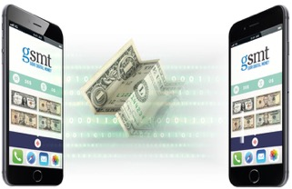
GSMT Pilot in Uruguay
gsmt
Mobile Operator
eNotes
Mobile Payment System
Reports
and data
Giori Digital Money
Global eNote Manager
Merchants
Hosting Provider
IMF on Uruguay Pilot for e-Peso, February 2019
The central bank aims at reducing transaction costs of cash (estimated at 0.6% of GDP), improve financial innovation by creating a supportive regulatory environment and infrastructure, and fostering financial inclusion by reaching out to non-banked segments of the society through mobile networks.
BIS on the expansion of the Innovation Hub, June 2020
“With this expansion, the Innovation Hub will be well placed to advance work on a broad range of issues of importance to the central banking community, including digital currency and digital payments …”
BCE Working Paper on CBDC, January 2020
“… a recently conducted pilot by the Central Bank of Uruguay, which would qualify as the most advanced and concrete CBDC experiment up to now …”
Person to Person
As simple as cash

Slide 27
Thank You!
David Mangini
david.mangini@gioridigital.com

